Slide 1

Amazon Sales Data Analysis & Business Insights

Slide 2





Problem Statement:
The objective of this project is to analyze sales data to understand customer behavior, product performance, revenue trends, and payment preferences. The goal is to identify key factors influencing revenue and provide insights to improve business growth and decision-making

Slide 3
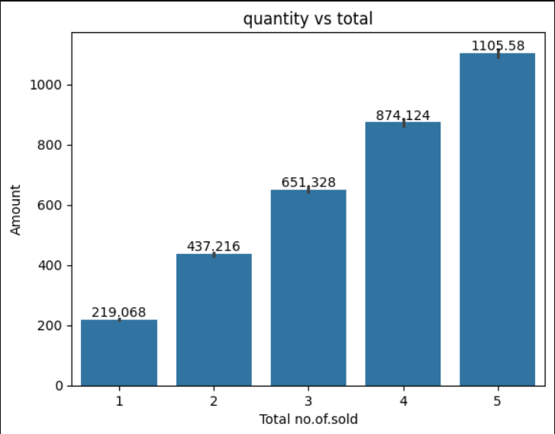
key insights:
1)As quantity sold increases, total amount also increases.
2) The increase is steady and almost linear.
3) Higher quantity sales lead to higher revenue, so selling more units is important.

Slide 4
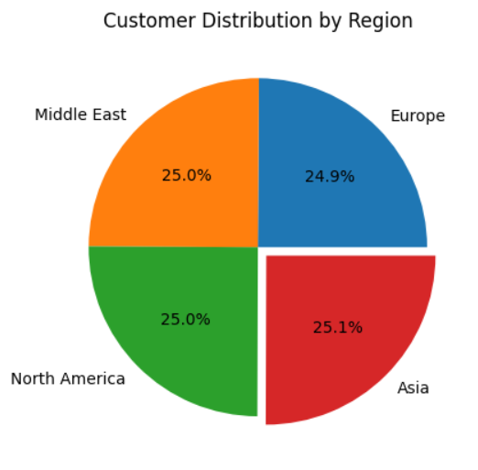
KEY INSIGHTS:
Customers are almost evenly distributed across all regions (~25% each)
Asia has a slightly higher share (25.1%), but the difference is very small.
The business has a strong and balanced presence in all regions, with no region dominating.

Slide 5
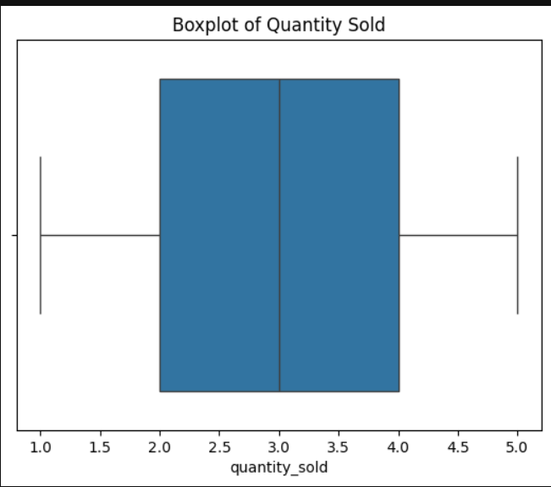
KEY INSIGHTS:
Median quantity sold is around 3, indicating most sales occur at this level.
The data is evenly spread between 1 and 5, showing balanced sales distribution.
No outliers are present, indicating consistent and stable sales patterns.

Slide 6
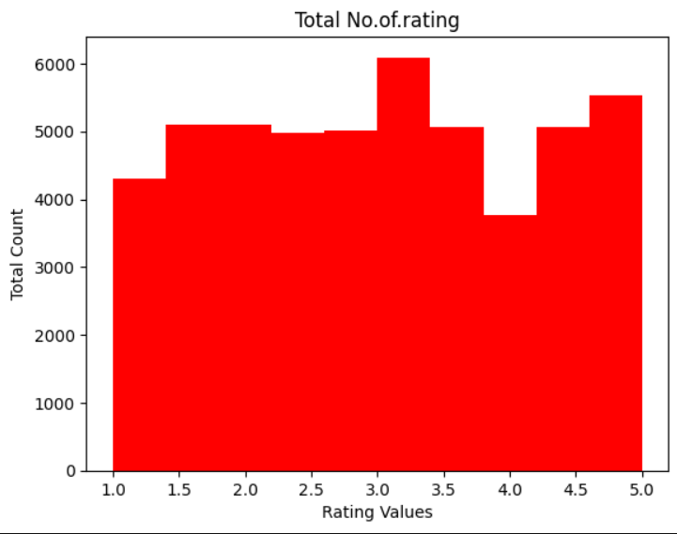
KEY INSIGHTS:
Ratings are distributed across all values (1 to 5), showing a wide range of customer feedback.
Most ratings are concentrated around the middle (around 3), indicating average customer satisfaction.
There is no extreme dominance of low or high ratings, suggesting balanced customer opinions.

Slide 7
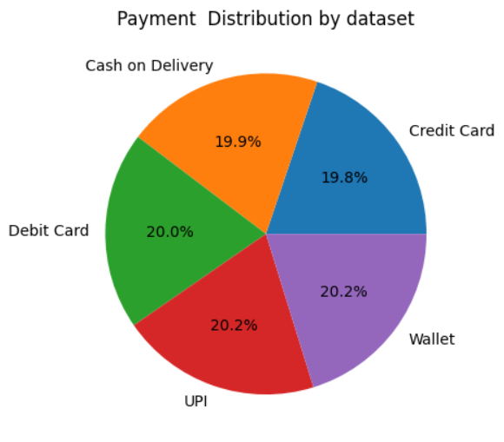
KEY INSIGHTS:
All payment methods are almost equally used, each contributing around 20%.
UPI and Wallet have a slightly higher share, indicating growing preference for digital payments.
No single payment method dominates, showing a balanced payment behavior among customers.

Slide 8
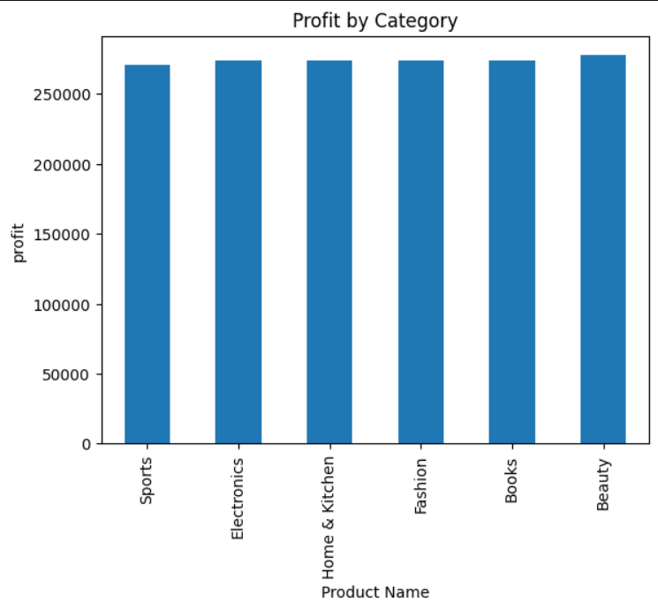
KEY INSIGHTS:
All product categories generate almost similar revenue, indicating balanced performance across categories.
Beauty category shows slightly higher revenue compared to others.
No category significantly underperforms, showing stable and diversified revenue sources.

Slide 9
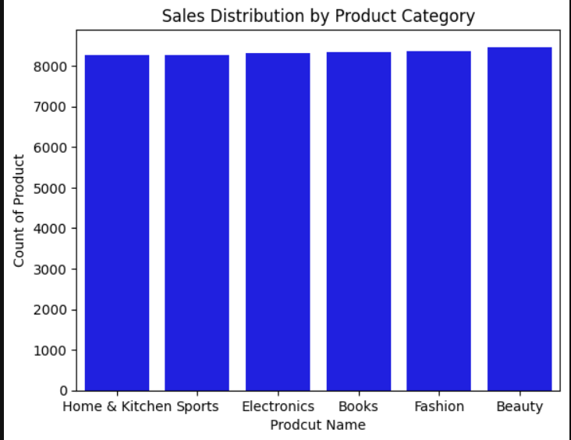
KEY INSIGHTS:
All product categories have almost equal sales count, showing balanced demand across categories.
Beauty category has slightly higher sales compared to others..
No category shows low sales, indicating consistent product performance across all categories..
There is no extreme dominance of low or hratings, suggesting balanced customer opinions.

Slide 10
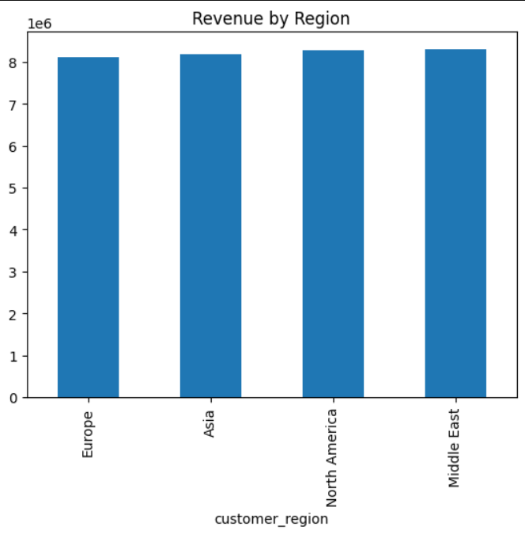
KEY INSIGHTS:
Revenue is almost equally distributed across all regions, showing balanced market performance.
Middle East and North America generate slightly higher revenue compared to other regions.
No region significantly underperforms, indicating stable and consistent global sales.

Slide 11
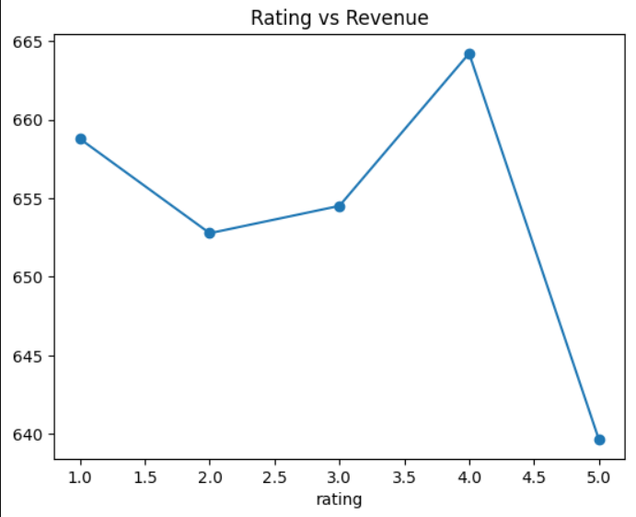
KEY INSIGHTS:
Revenue slightly increases from rating 2 to 4, indicating moderate ratings are associated with higher revenue..
Rating 4 generates the highest revenue, showing peak performance at this level..
Rating 5 shows a drop in revenue, indicating no strong positive relationship between highest ratings and revenue..

Slide 12
CONCLUSION:
Sales and revenue are evenly distributed across all product categories, indicating balanced business performance.
Beauty category shows slightly higher revenue and sales compared to other categories.
Customer distribution and revenue across regions are balanced, with slight dominance in Middle East and North America.
Quantity sold strongly impacts revenue, while ratings do not show a strong influence on sales.

